Slide 1


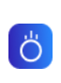

AstaCert
About
Contact
Do you want to invest in italian real estate?
We advise our investors to flip the best judicial auction opportunities on the market and sell them for a profit
Hover effect
Contact Us
Inflation Protection
While stocks, bonds, and cash tend to be negatively affected by inflation, real estate has historically proven to be an attractive hedge against inflation.
Volatility Hedge
Private real estate does not typically suffer from daily price fluctuations. Its low correlation to both stock and bond markets can provide portfolio stability.
Cash Flow Generation
Diversifying across property types and real estate strategies can help to deliver predictable cash flow in varied market conditions.

Slide 2
AstaCert
About
Contact
Why judicial auction?
Buy a property for
20-40%
less than its market value
TRANSPARENT
Most transparent way to purchase a real estate propriety as
every step is supervised by a tribunal
SECURE
All the properties are sold with a sworn report
HIGHLY PROFITABLE
Strong discounted properties due to the market's complexity and buyers' lack of skill

Slide 3
AstaCert
About
Contact
We advise you:
1
Choosing the best real estate opportunity on the judicial auction market
EXPLORE
2
INVEST
Buying at auction the property
EARN
3
Reselling or Renting it out

Slide 4

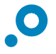

AstaCert
About
Contact
1 - EXPLORE
Explore investment opportunities
Are you looking to generate income and grow your portfolio’s value? We offer investments that match these objectives.
Income
Growth
High monthly current income
Majority of returns expected via capital appreciation
Target yearly returns
10-15%+
Target yearly returns
10-25%+
1-8yr
6m-2yr
Innovative investment strategies: Thanks to our Proprietary Software we can scout thousands of investment opportunities each day
Terms
Terms
Broad market: Over 200,000 properties traded in Italy each year through the judicial auction process with a value of 28.5 billion euros

Slide 5

AstaCert
About
Contact
In 3d bianco
2 - INVEST
Invest with confidence
A thorough due diligence process accompanies each investment advice.
Highly skilled professionals: We work with Engineers, Lawyers and Architects to analyze each property’s potentiality
Low risk: Usually, we do not renovate our proprieties: our strategy is to buy and sell the way they are without any further expenses

Slide 6
AstaCert
About
Contact
3 - EARN
SELL
Resell it or Rent it
Are you looking for a short-term lucrative operation or a stable passive source of income?
Sell: We aim to maximalize your profit by keeping near zero refurbishment costs
Rent: We seek for high trustworthy tenants that want to build long-lasting relationships
RENT

Slide 7
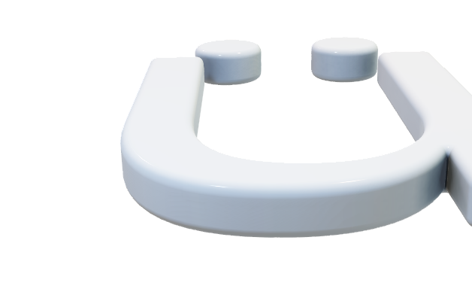
AstaCert
About
Contact
Why us?
+€20M
of properties traded since foundation
~15%
Average annualized ROI
3%
Our fee on invested capital
Una cosa così ma con il «?» al posto di questa lettera

Slide 8
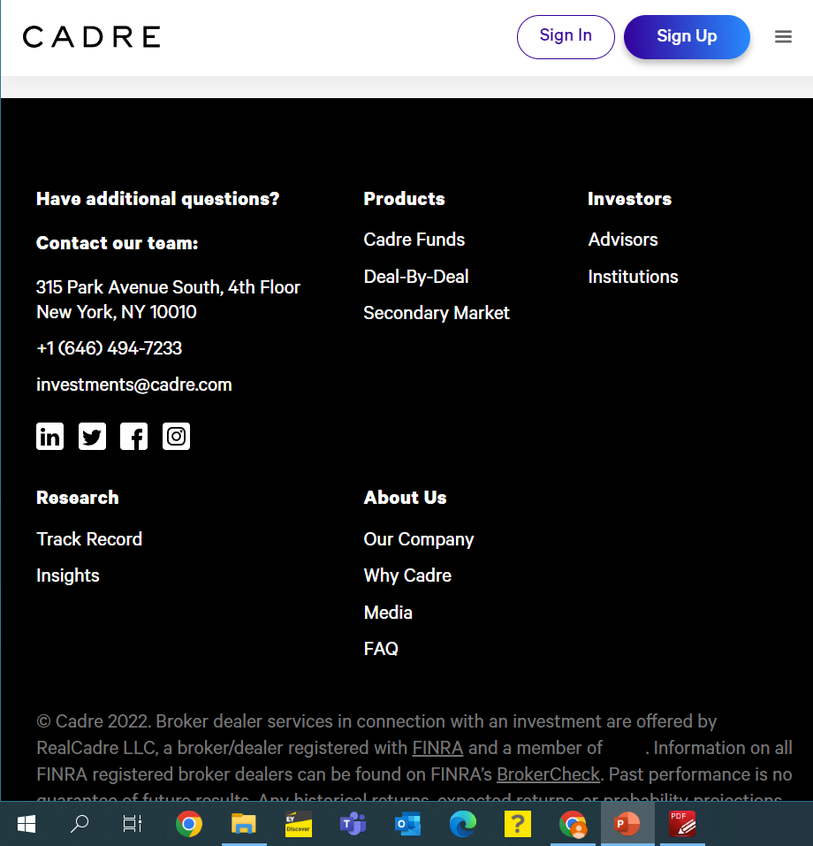
AstaCert
About
Contact

